Slide 1

Cracking the Code: Predicting Fracture Risk using Health and Lifestyle Data

Slide 2
Executive Summary
Context
Domain
Data
Outcome
Tech
Deliverable
Benefit

Slide 3
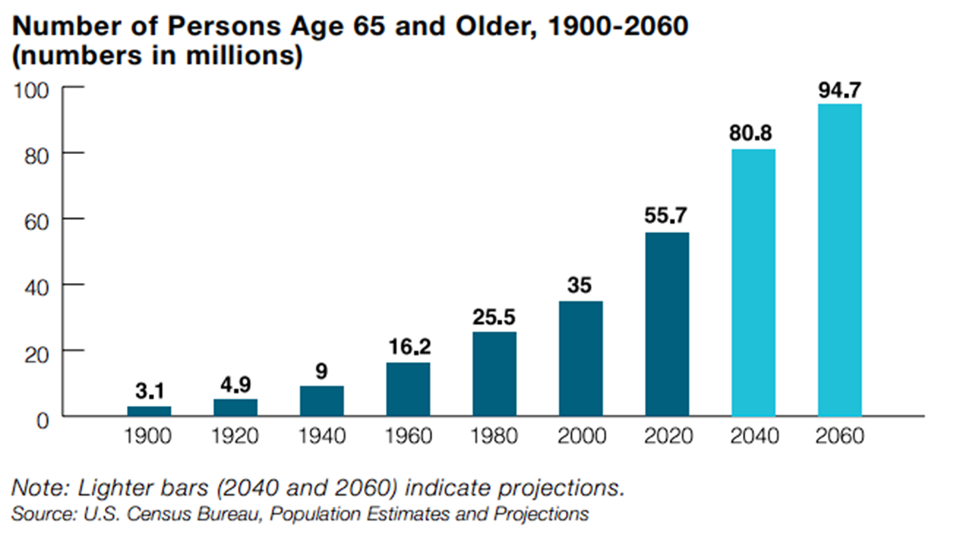
Context - Purpose
As the U.S. population ages, the incidence of fractures, particularly osteoporotic fractures in men over the age of 50, continues to rise, having a severe impact on quality of life and healthcare costs
"In 2019, the global number of new cases of fracture was estimated to be 178 million (95% UI 162–196), an increase of 33.4% (30.1–37.0) since 1990. The number of new cases of fractures was 102 million (93.4–111) in males compared with 76·4 million (68.7–85.3) in females."
Cauley JA. The global burden of fractures. Lancet Healthy Longev. 2021 Sep;2(9):e535-e536. doi: 10.1016/S2666-7568(21)00183-5. Epub 2021 Aug 20. PMID: 36098004.
Notes:
We can see from the chart that the number of elderly persons in the United States is only expected to increase, and with it the prevalence of fractures

Slide 4
Context - Purpose
Fracture Statistics
20-30% of all men will have an osteoporotic fracture in their lifetime
20% of hip fracture patients require long-term nursing home care
50% NEVER regain ability to walk independently
20% die within one year
33% of people are completely dependent following hip fracture
Adler RA. Osteoporosis in men: a review. Bone Res. 2014 Apr 29;2:14001. doi: 10.1038/boneres.2014.1. PMID: 26273515; PMCID: PMC4472130.

Slide 5
Context
This proof-of-concept model aims to predict the risk of osteoporotic fractures in men over the age of 50. This project serves healthcare professionals as a screening tool to identify high-risk patients.
By identifying high-risk patients, early interventions could be recommended based on model feature importance.
Notes:
Lifestyle factors such as physical activity and diet
Healthcare Professionals: We aim to provide them with a tool that can help them identify patients at high risk and guide them in implementing appropriate preventative measures.
Policy Makers: Our insights can help inform healthcare policies and resource allocation decisions aimed at reducing the prevalence of fractures and improving patient care.
At-risk Individuals: By making our findings accessible to the general public, we can raise awareness about the risks and prevention strategies associated with fractures, empowering individuals to take charge of their own health.

Slide 6
Domain Questions
Can we predict the risk of non-traumatic fractures in men over 50, focusing on health and lifestyle factors?
What specific features are indicative of increased fracture risk?
Notes:
A predictive model with quantifiable accuracy and reliability metrics (e.g., accuracy, precision, recall, and AUC-ROC) for assessing fracture risk based on these factors.

Slide 7
Data
The Osteoporotic Fractures in Men (MrOS) Study
Multi-center observational study of 5,994 men from six clinical centers in the U.S.
Baseline examinations conducted between 2000-2002
Four subsequent examinations have taken place, with the last examination in 2017
Participants contacted three times each year for ascertainment of fall, fractures, and deaths
Wide variety of variables including visual and cognitive function tests, bone mineral density (BMD), the collection of biospecimens, mobility, and objective assessment of physical activity levels
Notes:
Funded by NIH
With over 41,000 variables across seven time points
Focus on three datasets
Bone Density (B1AUG16)
Baseline Clinical Visit (V1FEB23)
Fracture Outcome (FAFEB23)

Slide 8
Outcome
The outcome of our research has resulted in a predictive model that correctly identifies 80% of patients that experienced a fracture in unseen test data.
We have also been able to identify risk factors and common trends through our exploratory analysis.

Slide 9
Technology
We leveraged supervised learning to classify patients at risk for bone fracture.
A variety of decision tree and gradient boosting algorithms such as Random Forest, XGBoost and LightGBM have been built as these models make for great classifiers and can also appropriately handle missing values.
Dimension reduction and feature extraction techniques have been implemented to handle the high dimensionality of the data.
Notes:
Missing null values

Slide 10
Deliverable
The deliverable we have is a proof-of-concept machine learning model that can be further developed into a model that can be deployed into a production workflow to screen elderly, male patients as at-risk for having an osteoporotic fracture within their lifetime.
Additional deliverables include an importance of features for identifying at risk patients and lifestyle intervention recommendations.

Slide 11
Benefits
Timely identification of individuals at high risk can lead to proactive management and significant reduction in healthcare complications and costs.
Enhanced Patient Outcomes
Financial Benefits Due to Efficient Resource Allocation
Policy Development
Risk Reduction
Notes:
Initially we believed our model would have benefits in six different categories. With the proof of concept screening tool we’ve developed, we believe that it can be leveraged in a way that aligns with the benefits we sought to achieve.
Enhanced Patient Outcomes
By predicting the likelihood of fractures based on lifestyle factors, medical history, and biomarkers, healthcare professionals can intervene proactively, enabling better patient care and improving overall health outcomes.
Financial Benefits
In terms of financial impact, preventing fractures can lead to significant cost savings for healthcare systems.
The predictive model will help healthcare systems identify high-risk individuals, allowing for more targeted interventions and efficient allocation of healthcare resources.
Policy Development
The insights derived from this project can be utilized by policy makers to draft guidelines and regulations aimed at reducing the incidence of fractures, especially in high-risk demographics such as senior citizens.
Risk Reduction
By identifying key risk factors and their impact on bone fractures, this project can contribute to the development of preventive measures, reducing the overall risk of fractures. This can result in lower long-term healthcare costs.
Social Impact
On a broader level, this project could significantly enhance quality of life for individuals, particularly senior citizens, by reducing their risk of fractures.

Slide 12
Technical Deep Dive
Data Details and Feature Engineering
Exploratory Data Analysis
Supervised Learning
Random Forests
XGBoost
Light GBM

Slide 13
Data Details – CHARACTERISTICS and Provenance
Our data source was the MrOS Study, a recognized, multicenter observational study. The data was collected through medical examinations and self-reported surveys across six clinical centers in the U.S.
The data includes a wide range of variables, including patient demographics, bone mineral density measurements, lifestyle factors, and health history. It was structured data with both numerical and categorical values, totaling around 5,994 records
Focus on three datasets
Bone Density (B1AUG16)
Baseline Clinical Visit (V1FEB23)
Fracture Outcome (FAFEB23)
Notes:
The quality and reliability of this dataset provide a strong foundation for our predictive model.

Slide 14
Data Details - Carpentry
Lifestyle and Health forms were separated and cleaned
Null values were handled through various methods
Reviewed study documentation and annotated clinical forms to find appropriate replacements
Survey responses had “chained responses” – often filled with zero (No)
Imaging problems during the DEXA scan imputed from a patient’s known DEXA values using K-Nearest Neighbors (KNN).
One hot encoding of categorical values (occupation, education, etc.)
Outcome variable "number of any non-traumatic fractures" (FAFXNT) converted to binary
Data from different visits and forms were merged into a final data set for analysis

Slide 15
Data Details - Feature Engineering
B1 Bone Mineral Density (BMD) data analyzed and consolidated with Principle Component Analysis (PCA)
Correlation Feature Reduction used to shrink the number of features and reduce effect of multicollinearity
Boruta Feature Selection used to account for the interaction of features within the entire dataset rather than in isolation
Train, Test and Validation split (80/10/10)
Synthetic Minority Over-sampling Technique (SMOTE) used to balance the dataset on target outcome

Slide 16
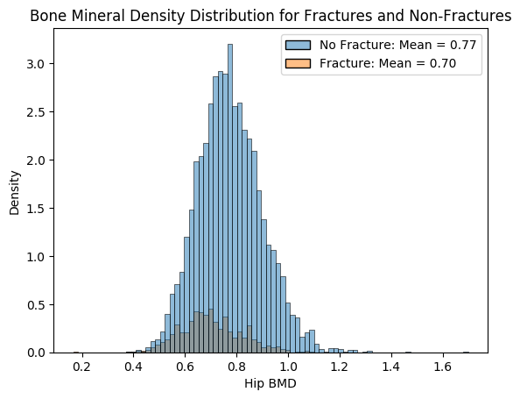
Exploratory data analysis – Bone Mineral Density (BMD)
Different BMD distributions in incidence of fracture and non-fracture.
Regional BMDs are highly correlated with each other, so feature reduction and decomposition techniques were explored.
Notes:
Key takeaways:
Distribution of Bone Mineral Densities had different distributions for incidence of fracture and non-fracture. Lower BMD leads to higher risk of fracture.

Slide 17
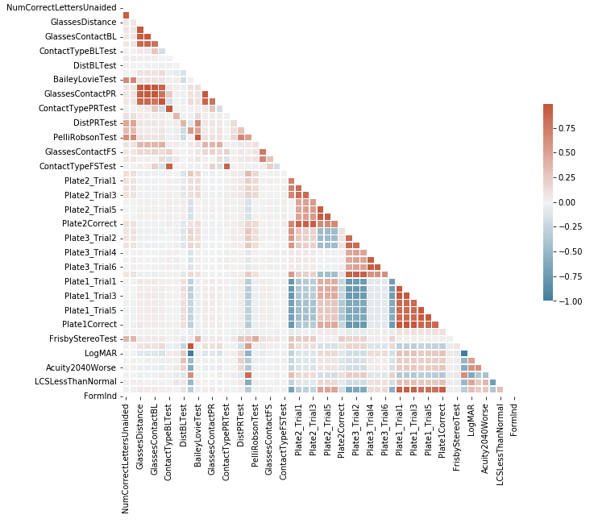
Exploratory data analysis – Functional Vision (Example of Lifestyle Forms)
Correlation heatmaps were built during analysis for lifestyle clinical forms to help with feature selection.
Used to check if we can reduce multicollinearity appropriately by removing highly correlated features.
Notes:
For instance, CorrectedAcuity and LogMAR are at -1.000000, acuity improves visual impairment decreases.
CorrectLettersPRTest and CorrectLettersBLTest have a high positive correlation of 0.992316, individuals performed well in the letter recognition test with glasses also performed well in the test with contact lenses.

Slide 18
Supervised Learning Methods
Random Forest, XGBoost, and LightGBM models were built for this project.
These models were chosen because of their tree-based approach at classification, ability to produce feature importance, and high out of the box performance.
XGBoost and LightGBM also had the added benefit of being able to handle null and missing values.
Notes:
Team members had good experience at building tree-based classifiers in the past.

Slide 19
Feature Importance
Random Forest | Light GBM | XGBoost
No prior fractures Bone Mineral Density History of arthritis or gout Takes aspirin 3x per week Ever drank more than 5 drinks per day ever day | Bone Mineral Density Height change from 25 Weight change from 25 Ability to complete chair stands Nottingham Rig results Time to complete a narrow walk | Fracture after 50 Fracture before 50 Aspirin 3x per day Bone Mineral Density
Notes:
RF: time in your life when you drank 5 or more drinks of any kind of alcoholic
beverage almost every day?
XGBoost differed from RF and LGBM, BMD was much lower importance

Slide 20
Evaluating the models
Given our goal was to develop a screening tool. Our objective was to maximize the F1-Score for a given recall threshold.
Recall of ~0.80 means only 20% of fracture patients are false negatives. This was considered an acceptable threshold considering the consequences of false negatives against the consequences of false positives.
From there, F1-Score was used to balance recall and precision.

Slide 21
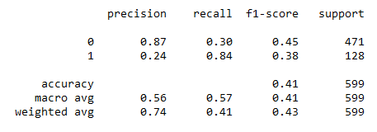
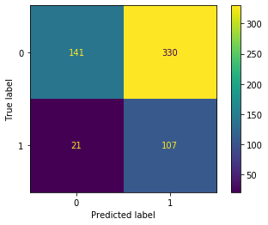
Random forest

Slide 22
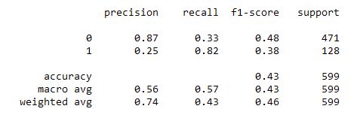
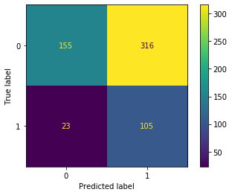
Light GBM
Boruta method was used to reduce dimensionality.
Once features were adequately reduced the model was hypertuned using Optuna.
Performance was moderate with an AUC of 0.63 on our hold-out set.

Slide 23
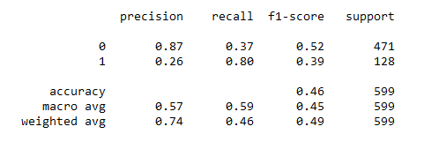
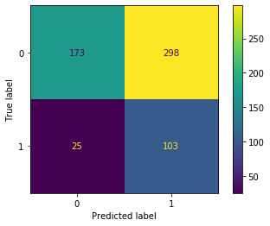
XGBoost Model #1
Highest performer based on achieving recall of 80% on the target class followed by F1.
Correctly identifies 80% of patients that experienced a fracture (103 of 128 cases).
While the model incorrectly predicts fracture in 63% of patients that did not experience fracture, we consider these as an increased safety net where missed high-risk cases could have severe implications

Slide 24
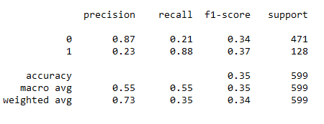
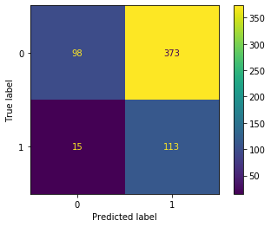
XGBOost Model #2

Slide 25
XGBOost Model #2

Slide 26
Model Summary
Models performed similarly. However, using the defined metric for success, XGBoost Model #1 performing the best.
 | Precision | Recall | F1-Score | Accuracy | AUC Score
Random Forest | 0.24 | 0.84 | 0.38 | 0.41 | 0.58
Light GBM | 0.25 | 0.82 | 0.38 | 0.43 | 0.63
XGBoost Model 1 | 0.26 | 0.80 | 0.39 | 0.46 | 0.63
XGBoost Model 2 | 0.23 | 0.88 | 0.37 | 0.35 | 0.62
Notes:
Defined metric of success: At least 80% recall, followed by F1 optimization.

Slide 27
Data Story
Predictive Model
Relevancy
Value

Slide 28

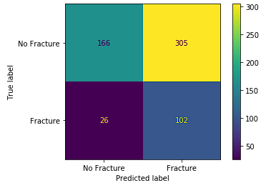
Predictive Model
Highest performer: XGBoost
Correctly identifies 80% of patients that experienced a fracture (103 of 128 unseen cases).
While the model incorrectly predicts fracture in 63% of patients that did not experience fracture, we consider these as an increased safety net where missed high-risk cases could have severe implications

Slide 29
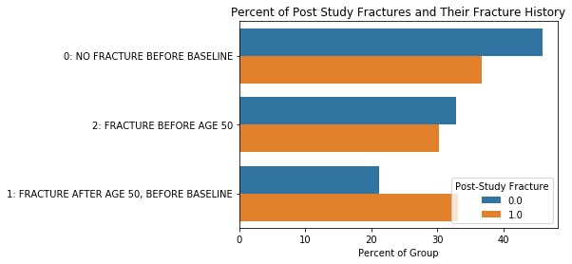
Relevancy
Answers: How do various features relate to incidence of fracture?
We see different distributions of Bone Mineral Densities for populations with and without incidence of fracture
Can more easily tell us the direction of the effect
For example, nearly 50% of people who didn’t have a fracture post study had never had a fracture before.

Slide 30
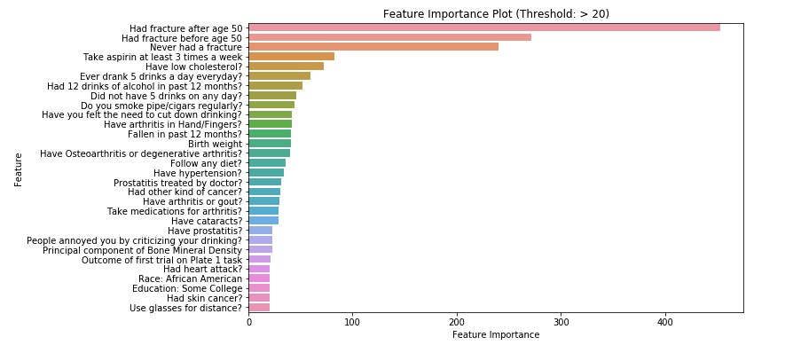
Relevancy
Answers: How do various features relate to incidence of fracture?
Identifies risk factors for fractures based on feature importance.
Feature importance was extracted from the tree-based models.
Health Practitioners could take these risk factors into account when discussing lifestyle interventions.
Common elements in the feature importance extracted from our models:
Bone Mineral Density
Previous occurrence of fracture
Excessive alcohol consumption
High aspirin usage

Slide 31
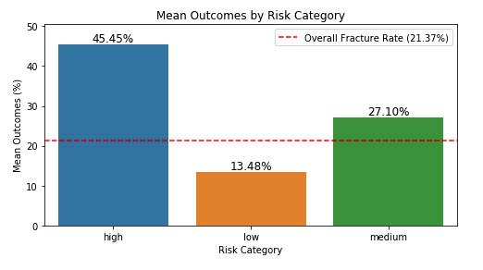
Relevancy
Answers: Can we predict the risk of non-traumatic fractures in men over 50, focusing on health and lifestyle factors?
Stratification of risk for patients and continued monitoring
Among patients in the high-risk category, nearly 45.5% experienced a fracture, far exceeding the overall fracture rate of 21.37% in the dataset.
Those categorized as medium risk had a fracture incidence of 27.1%, also above the overall fracture rate.
Meanwhile, the low-risk group had a fracture rate of just 13.5%, significantly lower than the average.

Slide 32
Value
Targeted Interventions: By identifying those at a high risk of fractures, healthcare practitioners can direct preventative measures and interventions to those who need them most. This includes recommending lifestyle changes, prescribing medication to strengthen bone density, or initiating other treatments as deemed necessary.
Efficient Use of Resources: Healthcare resources are often limited. By distinguishing the patients who are at a higher risk of fractures, resources can be allocated more efficiently, focusing on those most in need.
Early Detection and Prevention: With the ability to predict who is at high risk of fractures, healthcare practitioners can take proactive steps to manage and potentially reduce that risk, preventing fractures before they occur. This can significantly improve patient outcomes and quality of life, particularly for those at high risk.
Personalized Care: This risk stratification can also contribute to more personalized healthcare. Understanding a patient's individual risk can help tailor their care plan, making it more effective and suited to their specific needs.
Key Risk Factors Identified: Healthcare practitioners can address these risk factors for high-risk patients through preventive interventions. These include Bone Mineral Density, Previous occurrence of fracture, Excessive alcohol consumption, and High aspirin usage.

Slide 33
Next Steps
Future efforts can focus on refining the model with additional and more diverse data.
Feedback from healthcare practitioners who apply this model could generate insights into further enhancing utility of the model.
Employing Stacked Generalization
As each model delivered different feature importance rankings, there is an opportunity to build a meta-model using the base models built for this project to leverage the strengths of each.

